Slide 1

Web2 vs Web3: The Evolution of the Internet
The internet is evolving. Web2 and Web3 represent distinct paradigms in online interaction and data management. This presentation explores their differences, implications, and the future of our digital world.

Slide 2
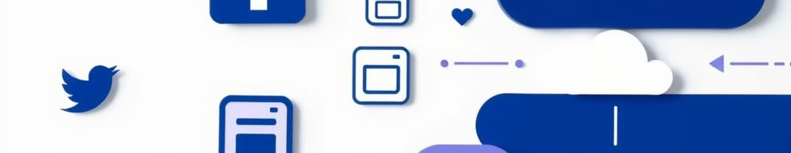



What is Web2?
Cloud Computing
Mobile-First
Social Networking
Centralized data storage and processing power enable scalable web services.
Responsive design prioritizes seamless experiences across devices.
Platforms connect users globally, facilitating content sharing and interaction.

Slide 3
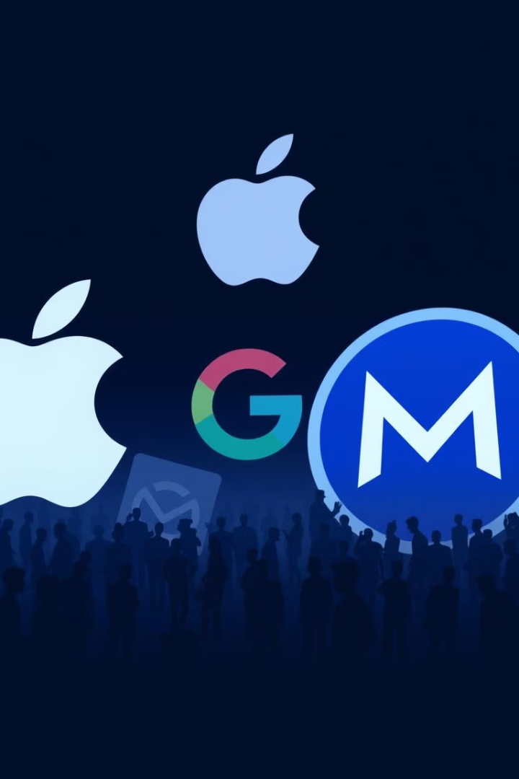
Limitations of Web2
1
Centralized Control
2
Privacy Concerns
Tech giants hold disproportionate power over user data and online experiences.
Personal information is often exploited for targeted advertising and profit.
3
Content Censorship
Platforms can arbitrarily remove or suppress user-generated content.

Slide 4
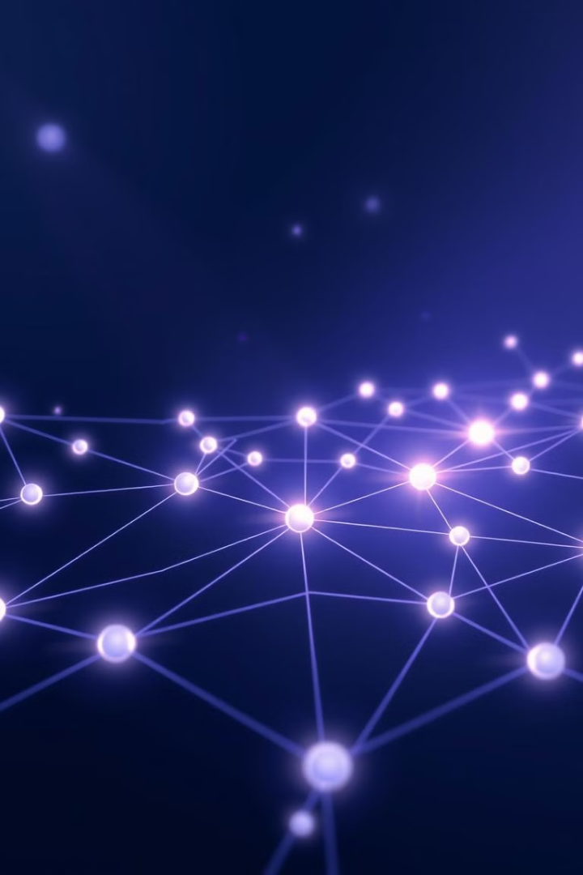
Introduction to Web3
1
Origins
Web3 emerges from blockchain technology and cryptocurrency innovations.
2
Vision
A decentralized internet where users control their data and digital identities.
3
Implementation
Developers create dApps and protocols to realize Web3 principles.

Slide 5

Key Principles of Web3
Decentralization
Transparency
User Empowerment
Distributed networks eliminate single points of failure and central authorities.
Open-source code and public blockchains ensure accountability and trust.
Individuals gain true ownership and control over their digital assets.

Slide 6
Decentralization and Blockchain
Blockchain Technology
Smart Contracts
Tokenization
Immutable, distributed ledgers record transactions securely and transparently.
Self-executing agreements automate processes without intermediaries.
Digital assets represent real-world value, enabling new economic models.

Slide 7




Benefits of Web3
Data Sovereignty
Censorship Resistance
Financial Inclusion
Users have full control over their personal information and digital identities.
Decentralized networks make content removal or suppression nearly impossible.
Cryptocurrency and DeFi provide banking services to the unbanked globally.

Slide 8

Challenges and Adoption
Scalability
Improving transaction speed and capacity
User Experience
Simplifying complex interfaces and processes
Regulation
Navigating evolving legal frameworks
Energy Consumption
Addressing environmental concerns of blockchain networks

Slide 9
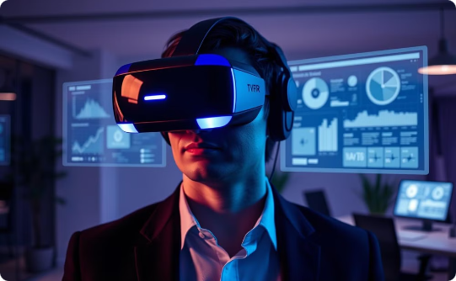
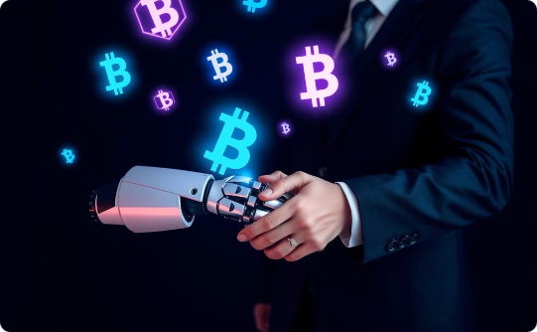
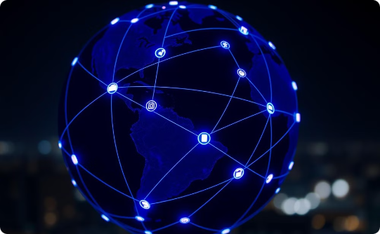
The Future of the Internet
Immersive Experiences
AI Integration
Internet of Things
VR and AR integrate seamlessly with Web3, creating new realities.
Decentralized AI enhances user experiences while preserving privacy.
Web3 protocols enable secure, autonomous device interactions.

Slide 10
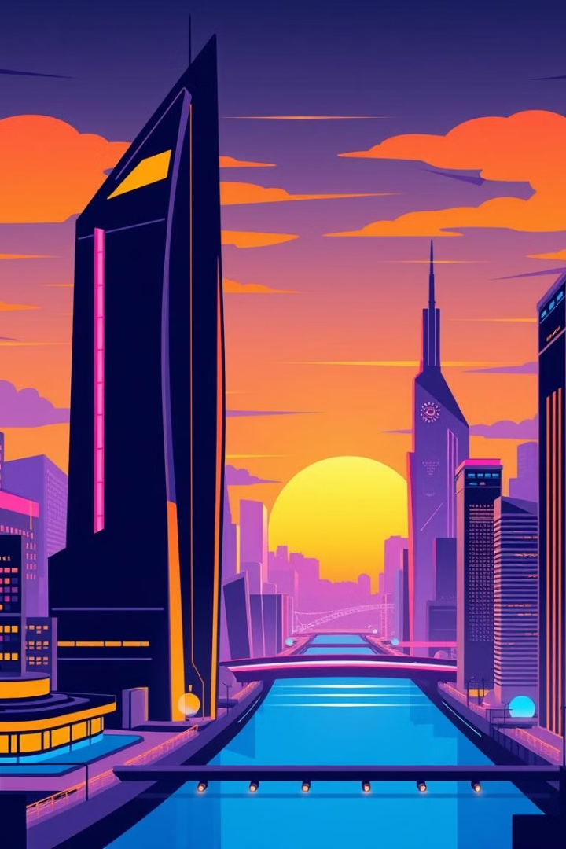
Conclusion
1
Paradigm Shift
2
Ongoing Evolution
Web3 represents a fundamental change in how we interact online.
The transition from Web2 to Web3 will be gradual and transformative.
3
User-Centric Future
Embracing Web3 principles can lead to a more equitable digital world.

